Slide 1


The innovation hub
DESIGN THINKING AND IDEA LABORATORY
GROUP NO. 14
Group no .14
Group name:
THE INNOVATION HUB

Slide 2
Progress partners
PROJECT : Medicine tracking and distribution system
MEMBERS :
1. Supriya Gawali [ leader] 2. Sanika Kalwaghe 3.Samruddh Shelke 4.Tejas Avhad 5.Vishnu Verma

Slide 3
Theory of prioritization

Slide 4
 | 1000 g | 100 g | 10 g | Total
Network issues | 4000 | 0 | 10 | 4010
Transaction problems | 5000 | 0 | 0 | 5000
Transportation updates | 3000 | 100 | 10 | 3110
Temperature monitoring | 1000 | 300 | 10 | 1310
Lack of storage | 5000 | 0 | 0 | 5000
Medicine shortage | 2000 | 300 | 0 | 2300
Misguidance | 1000 | 0 | 40 | 1040
History management | 1000 | 400 | 0 | 1400
Failure in transportation | 2000 | 100 | 20 | 2120
Quality maintaining | 0 | 0 | 50 | 50
Stock exchange | 5000 | 0 | 0 | 5000
Inventory management | 2000 | 300 | 0 | 2300
Lack of accuracy | 0 | 500 | 0 | 500
Lack of knowledge | 3000 | 0 | 20 | 3020

Slide 5
Prioritization Graph
Scale
On Y-axis
For 1000 g
1cm = 1000 g
For 100 g
1cm = 100 g
For 10 g
1cm = 10 g

Slide 6
Theory of prioritization

Slide 7
Problem statement
Problem statements
How we can provide safety in transactions to users with medicine ATM
How we can increase storage capacity of medicine ATM
How we can remove Expired medicines with the help of stock exchange

Slide 8
SCAMPER
S = substitute
C = combine
A = adapt
M = modify
P = put to another use
E = eliminate
R = reverse
The SCAMPER technique in design thinking is used to stimulate creativity and generate ideas by prompting questions about Substituting, Combining, Adapting, Modifying, Putting to another use, Eliminating, and Reversing elements of a design

Slide 9
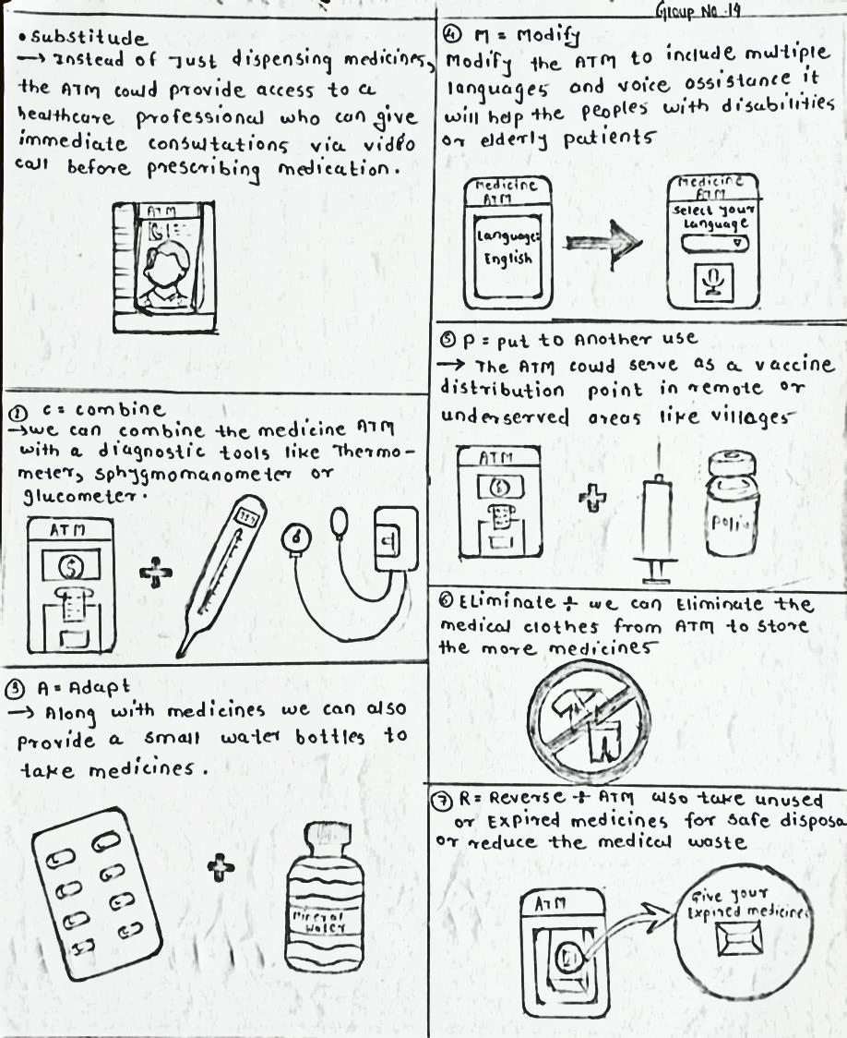
SCAMPER
Selected technique From SCAMPER
COMBINE
By combining the medicine ATM with diagnostic tools like thermometer sphygmomanometer It will helps the users To check primary illnesses
ADAPT
Along with medicine we can also provide a small water bottles to take medicines it will helps in emergency conditions also to Attract a end users towards ATM
Put to other use
The ATM could serve as a vaccine distribution point in remote or underserved areas like villages

Slide 10
Journey Map

Slide 11
Journey Map
End users
Matured person Amit
Old man
Amit approaches the medicine ATM for the first time
Call his friend and get positive review about ATM
Try to get medicines from the ATM
Saw the advertisement poster about medicine ATM instruction app
Check the app first time and get all instructions about how to use ATM
Fear about is their medicine available or not in the stock
Check the stock in the APP
Want to check oxygen level
Find oximeter their
Check for the cash payment
Successfully did there payment
Finally return to their home
Events :- for the matured person amit

Slide 12
Journey Map
Confidence level

Slide 13
Journey map
He felt dizzy because of overtime travelling through metro
Saw the Medicine ATM on Metro station
Asking to peoples how to use ATM
Finally one boy told them about app
Find sphygmomanometer over their
Don’t know How to use sphygmomanometer
Saw in the app
After some time results will come
Their reports are positive
ATM suggest some medicines
Get medicines from ATM
After some time he feels good
Events :- For old Man

Slide 14
Journey map
Confidence level

Slide 15
Thank you !

